Slide 1

Aviation Business Analysis: Determining Which Aircraft Are The Lowest Risk For The Company To Start This New Business Endeavor
Nancy Maina

Slide 2
Project Outline
Background
Data exploring and data cleaning
Risk assessment analysis
Visualizations and insights
Recommendation
Conclusion
References

Slide 3
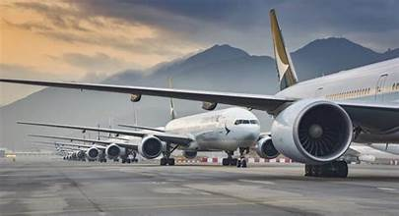
Background
Dataset provided by the National Transportation Safety Board (NTSB).
contains valuable information on civil aviation accidents and selected incidents spanning over six decades.
Our objective: analyze this data into actionable insights that will guide stakeholders decision-making process as we venture into the aviation industry.

Slide 4

Data exploring and data cleaning
Understanding the Data: Familiarize with the dataset's structure, and variables.
Handling Missing Values: Address any missing or incomplete data points.
Aggregate the data in a meaningful way to derive insights at a higher level of abstraction

Slide 5
Risk assessment analysis, &visualizations insights
Identify the best type/model of business based on the analysis of the purpose of flight
Identifying High-Risk Factors: Explore variables such as aircraft type(make & model), injury severity and engine type
Comparative Analysis to compare the safety records of different aircraft types to ascertain which ones have historically demonstrated lower risk profiles.

Slide 6
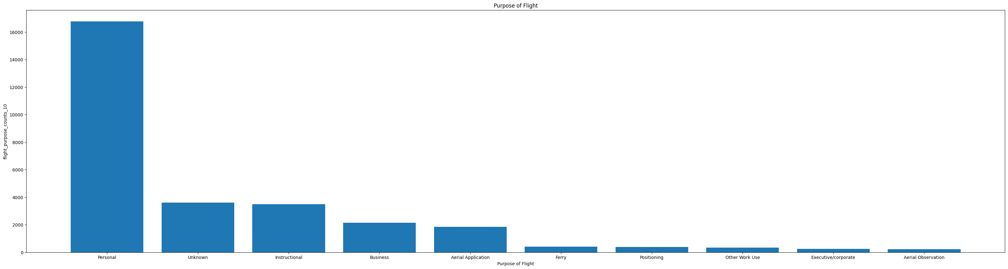
Identify the best type/model of business based on the analysis of the purpose of flight
Purpose of flight
Personal 16757
Unknown 3608
Instructional 3497
Business 2150
Aerial Application 1847
Ferry 404
Positioning 372
Other Work Use 342
Executive/corporate 256
Aerial Observation 212
Public Aircraft 164
Skydiving 14
The most popular purpose of flights for personal reasons

Slide 7
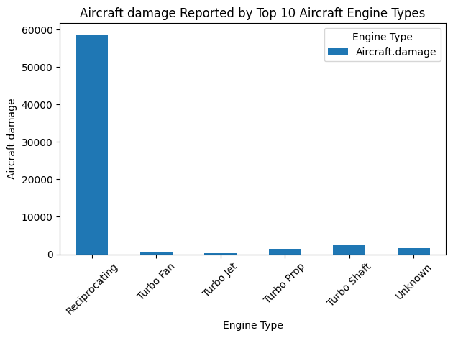
Identifying High-Risk Factors
Best engine type recommended : Turbo fan

Slide 8
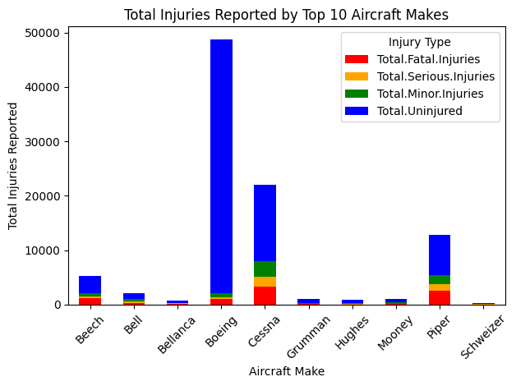
Best Air craft make recommended : Boeing, Cessna

Slide 9
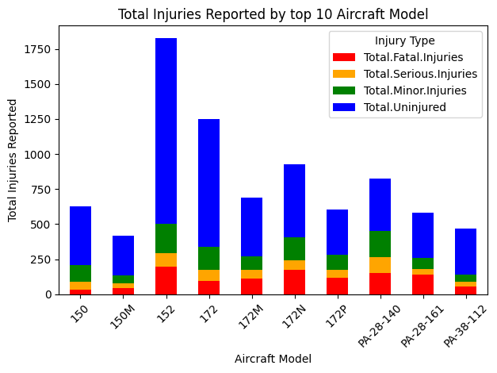
Best Air craft make recommended : DC-10-10', '727-200', 'DC-10-30

Slide 10
Recommendation
Most popular purpose of flight: Personal
Best 3 aircraft commercial make based on total uninjured: ['Boeing', 'Mcdonnell Douglas', 'Cessna']
Best 3 commercial aircraft model based on total uninjured: ['DC-10-10', '727-200', 'DC-10-30']
Best aircraft engine: Turbo Fan

Slide 11
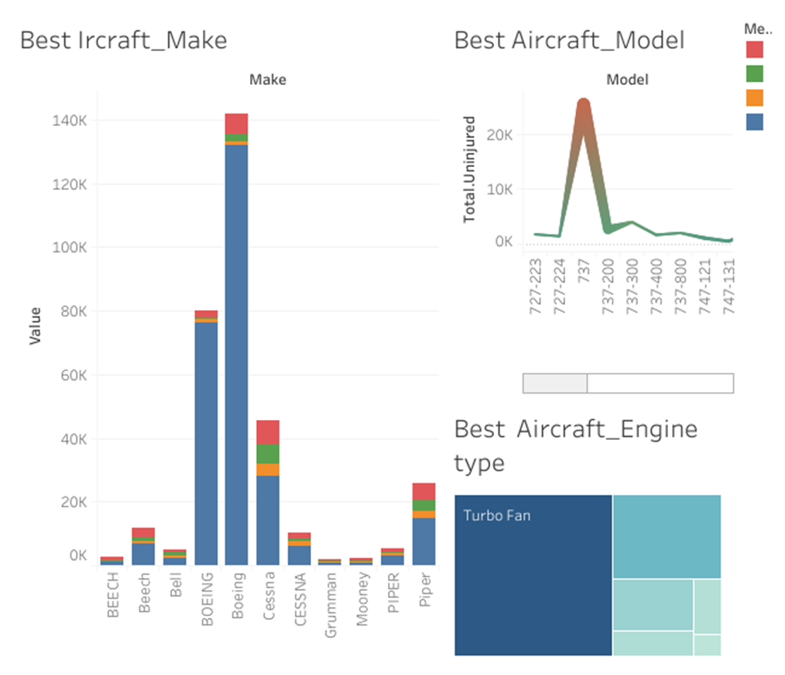
Dashboard

Slide 12
References
https://github.com/learn-co-curriculum/dsc-phase-1-project-v3
https://www.kaggle.com/datasets/khsamaha/aviation-accident-database-synopses

